Slide 1

Cognitive Impairment: Reflow
http://all.rit.edu
Developed With the Support of the NSF Award #1825023

Slide 2

Index
What is a Cognitive Impairment?
What is Reflow?
Reflow Example
How Can We Fix Reflow Issues?
Who Does This Help?
Summary

Slide 3




What is a Cognitive Impairment?
A cognitive impairment is something that inhibits a user's ability to perform one or more cerebral tasks
Cognitive impairments can be physical, mental, or behavioral
Examples of some cerebral tasks are:
Memory Problem Solving
Comprehension Processing

Slide 4
What is Reflow? 1/2
Reflow is the way browsers and document readers organize content to fit the width of the viewport (window)
Many of you may know reflow by another name: ‘Responsive Web Design’
Reflow is controlled by media queries in CSS
An example of this is: @media only screen and (max-width: 600px)
Notes:
What is a media query?
What is CSS?

Slide 5
What is Reflow? 2/2
According to WCAG 2.0, to be considered cognitively accessible, the interface should be just as visible when zoomed in 400%
In general, interfaces should deliver the same content in similar ways across all viewing platforms
Users should also know where they are at all times and be able to navigate to where they want to go in an intuitive fashion

Slide 6

Reflow Example 1/5
You and your friends want to visit a local pub for food
For one reason or another, you cannot make out what is on the page

Slide 7

Reflow Example 2/5
So, like most savvy people your age you zoom in right?
Well, you can see it now, but what happened to the rest of the page?

Slide 8
Reflow Example 3/5
This is where reflow becomes a big problem
For those of us with cognitive impairments, it becomes a nightmare of trying to remember which element relates to which part of the menu and navigation is no longer straight forward

Slide 9

Reflow Example 4/5
Let’s compare the previous example to another site that handles reflow well

Slide 10

Reflow Example 5/5
After zooming in 400%, (the standard according to WCAG2.0) the content is just as accessible and there is no horizontal scrolling

Slide 11
How Can We Fix Reflow Issues? 1/3
As mentioned previously, this is controlled through media queries
We can use CSS to set rules for how our content is viewed
Rules such as the previously mentioned
@media only screen and (max-width: 600px)
Take this example, which will turn the HTML body element background color to blue when the viewport is 600px or smaller
@media only screen and (max-width: 600px) { body { background-color:blue; } }

Slide 12
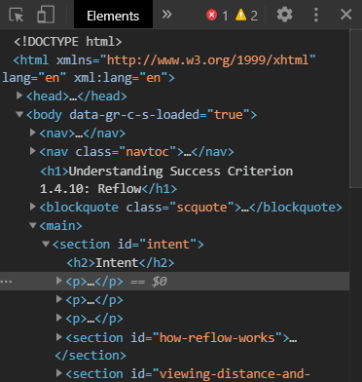
How Can We Fix Reflow Issues? 2/3
As developers, adapting for reflow requires testing in different viewports
Most browsers support this as a developer feature
In the example to the right, I am using chrome, however the steps are very similar for any modern browser
To replicate my process, while in Chrome press F12 or right click and select Inspect
You should see something like the image to the right

Slide 13

How Can We Fix Reflow Issues? 3/3
Select the icon in the top left
Congratulations! You are now seeing your viewport from a new display size
Have fun messing with the viewport and seeing your creation or other pages from different perspectives using the menu looking like the image below.

Slide 14
Who Does This Help? 1/2
Like most accessibility changes, this helps everyone
Specifically, the recommended change helps anyone who may have a cognitive impairment that would otherwise have difficulties with the navigation and understanding of how the elements on the page relate to each other

Slide 15
Who Does This Help? 2/2
Attention deficit hyperactivity disorder (ADHD)
Autism spectrum disorder (ASD)
Seizure disorders
Mental health disabilities - IE Schizophrenia, anxiety, depression, and paranoia.
Learning disabilities
Down syndrome
Dyslexia

Slide 16
Summary
Reflow is a very important topic to know and understand
Individuals with cognitive impairments will not be able to navigate your work if it is not responsive
Being able to scale content to 400% is the WCAG standard
You can use browser tools to accomplish the above task

Slide 17
Further Resources
Try media query examples for yourself at w3schools
HCI concept: Fitz Law
VisBug developer chrome plugin to identify content sections
Web design basics for reflow

